Slide 1
PR- 28
Signal Processing Primitives With Quantum Algorithm
G-RIIS
(G=Gal Winer(Team Lead), R=Risav, I= Ibrahim,I=Ini Ekpenyong
S=Subhashis )

Slide 2
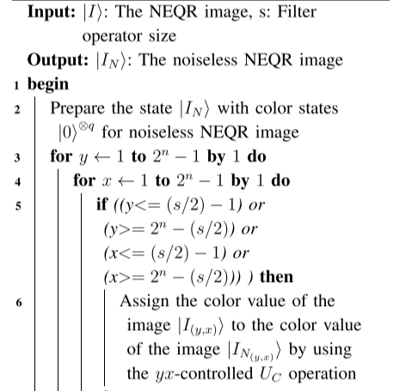
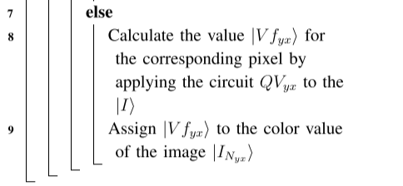
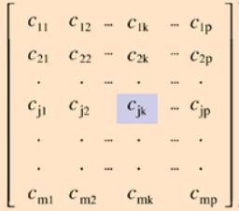
Algorithm for QMF(Quantum Mean Filter)

Slide 3
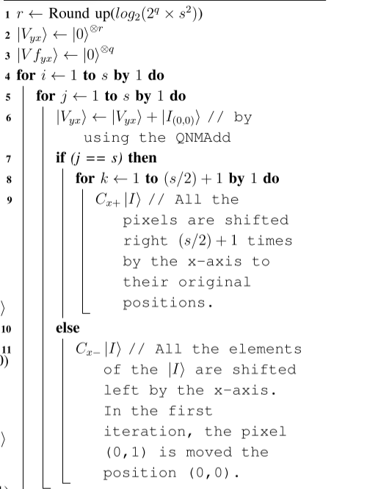
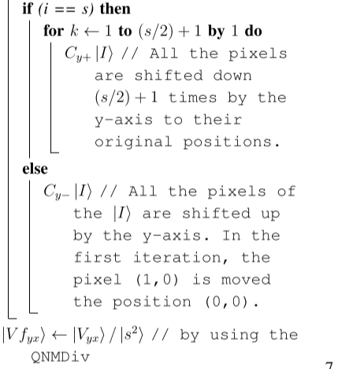
Algorithm of the operation QVxy

Slide 4
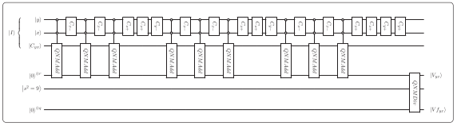
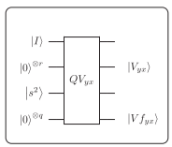
The quantum circuits of the operation QVyx for 3×3 filter operator
simplified graph of QVyx

Slide 5
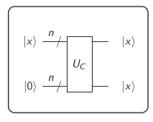
Arithmetic operation that We use In this Project
1. The unitary UC operation for copying an n-qubits state |x> to another n-qubits state
2. The copies of the inputs are made in order not to change the inputs.

Slide 6
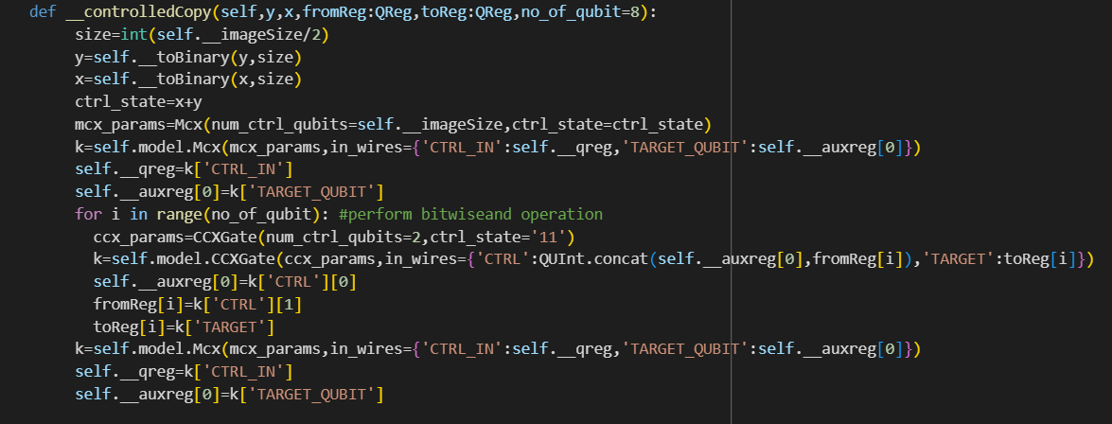
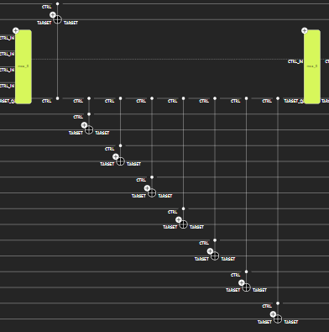
Classiq Implementation for implementing Uc that copy state of qubits

Slide 7
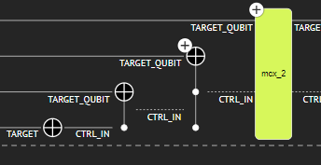
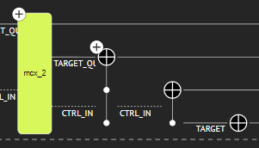
Implementation of CyclicShiftXLeft, CyclicShiftXRight
CyclicShiftXLeft
CyclicShiftXRight

Slide 8
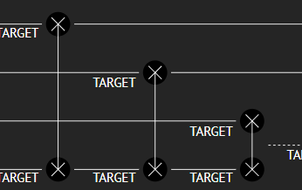
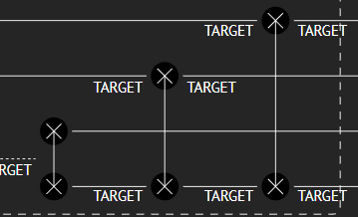
Implementation of CyclicShiftYUp, CyclicShiftYDown
CyclicShiftYUp
CyclicShiftYDown

Slide 9
Circuit and Qubit info and affecting factor
No Of Qubit To be Neded depends upon: 1. Size of the image
2. Size of kernel But the size mainly depends upon the size of the kernel rather than the Size of image.
For 4x4 image with 3x3 kernel we nearly need about 75 qubits

Slide 10
Implementation that is Left for completion of mean Filter
Quantum Non Modular Division
While using Adder the output i.e. Sum is always stored to the new qubits that causes increase in the requirements of qubits
Measuring the only the filtered Register where quantum Information of the image is stored
Decoding Quantum State to back to the Image

